Slide 1
Benchmarking the CMA-ES with Rank one update on the bbob noiseless test suite.
Presented by:
Raneem Madani, Ikhlas Enaeih, Zeidan Braik
Derivative Free Optimization Master 2 Optimization.

Slide 2
Evolution Strategies:
You evolve iteratively better to reach a desired target.
Motivation:
Some problems make a function difficult to solve:
Dimensionality, ill conditioning, non smooth level sets etc….
Blackbox Scenario:
You have inputs and outputs.
minimization in this scenario requires finding:
Both the input that yields the minimum output.

Slide 3
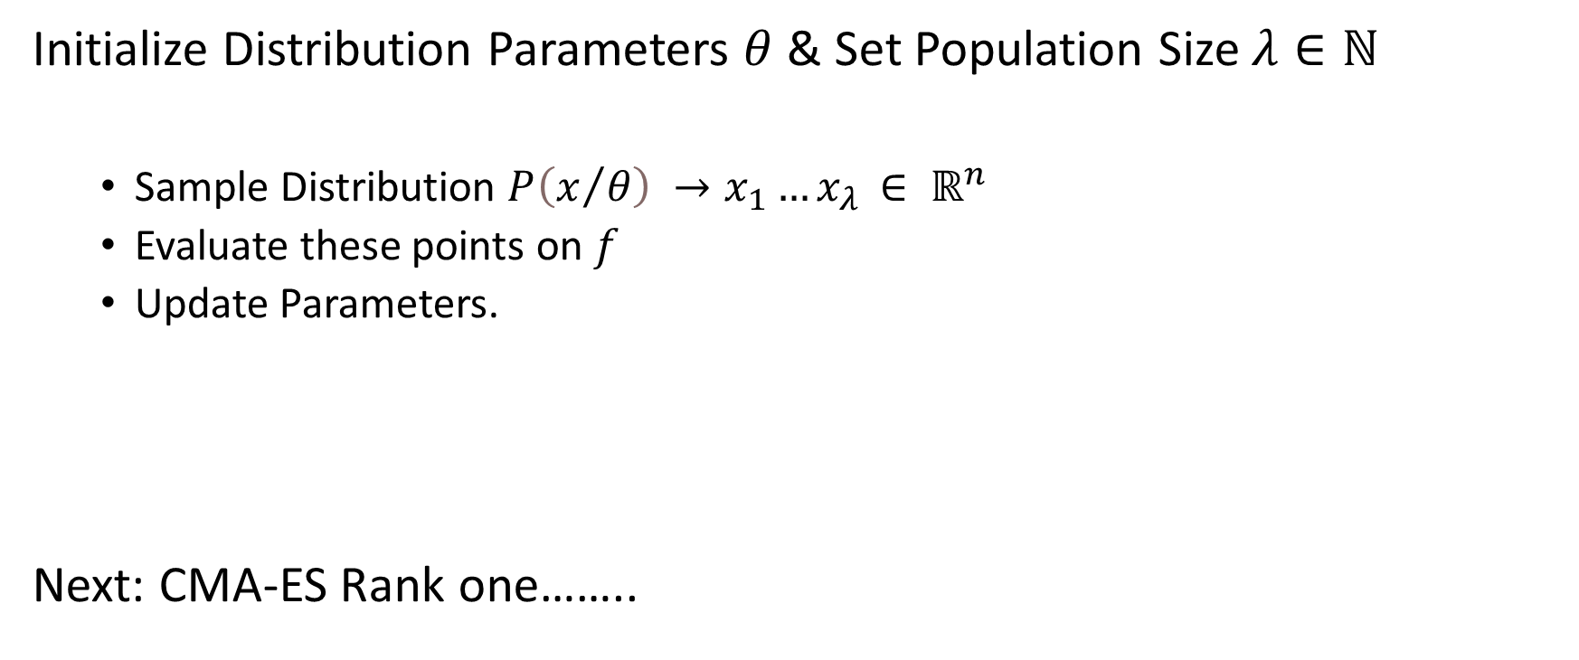
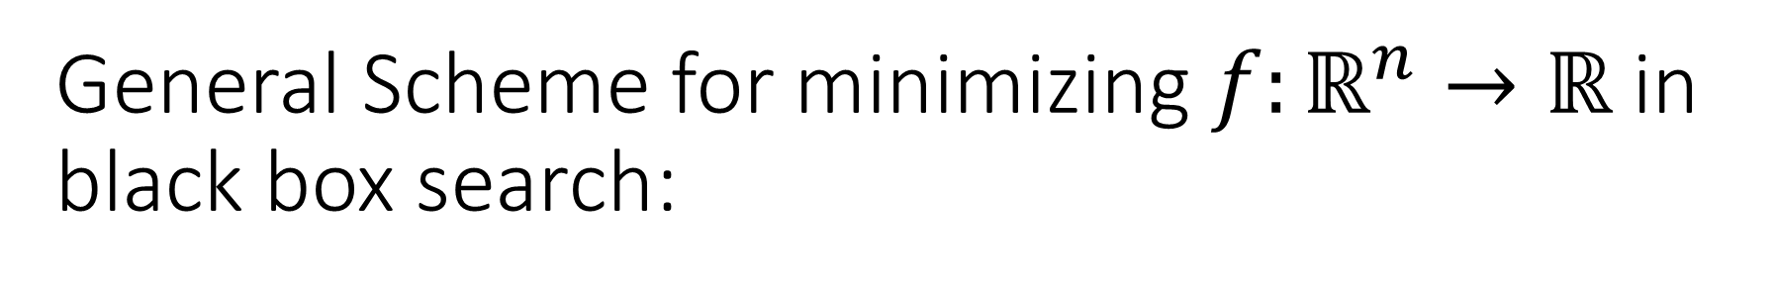
General Scheme for minimizing $f:ℝ^{n}→ℝ$ in black box search:
Initialize Distribution Parameters $θ$ & Set Population Size $λ∈ℕ$
Sample Distribution $P\left(x/θ\right) →x_{1}…x_{λ }∈ ℝ^{n}$
Evaluate these points on $f$
Update Parameters.
Next: CMA-ES Rank one……..

Slide 4
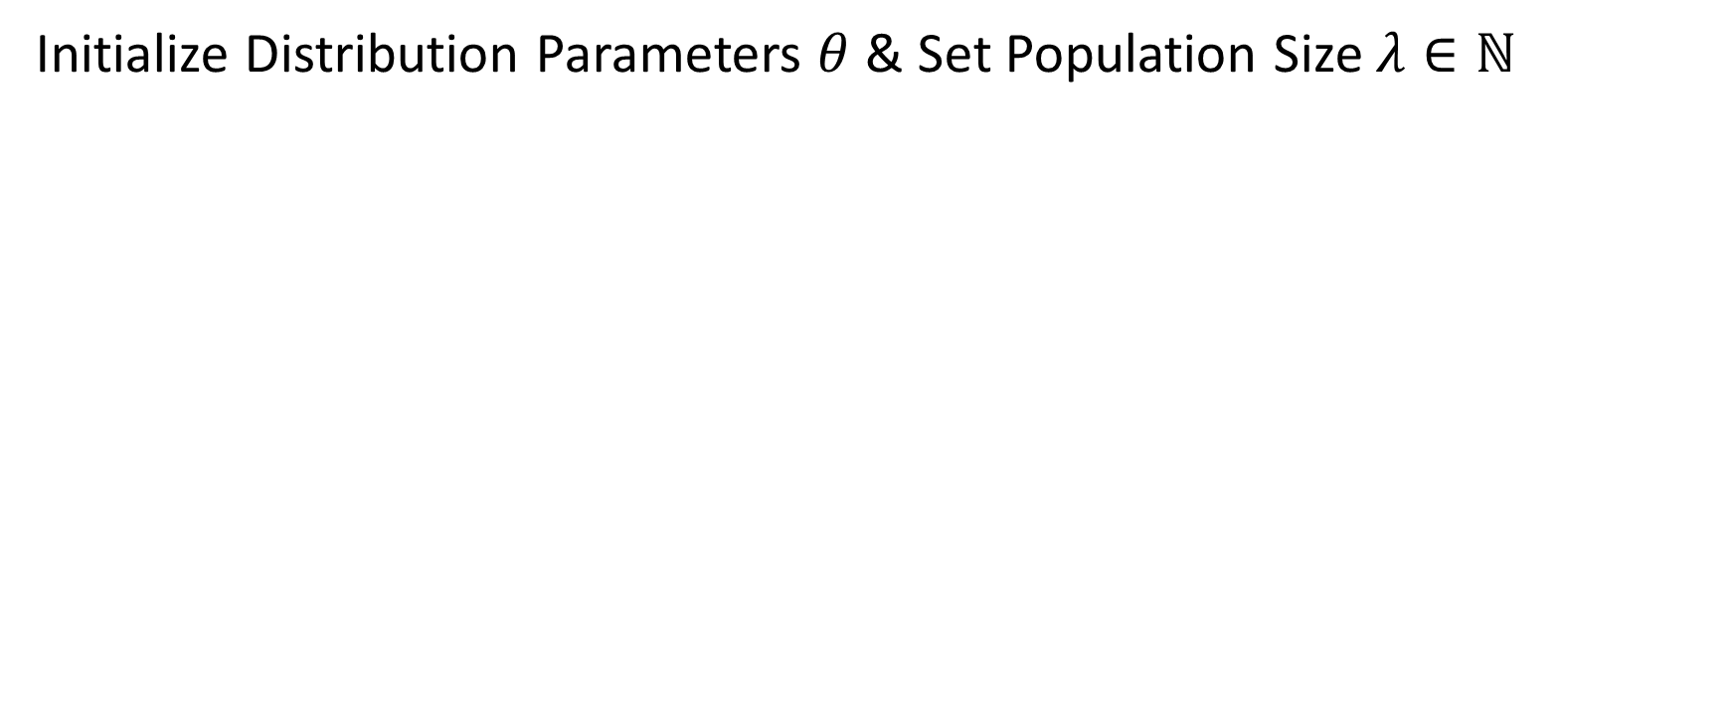
CMA – ES with Rank One Update
Initialize Distribution Parameters $θ$ & Set Population Size $λ∈ℕ$

Slide 5
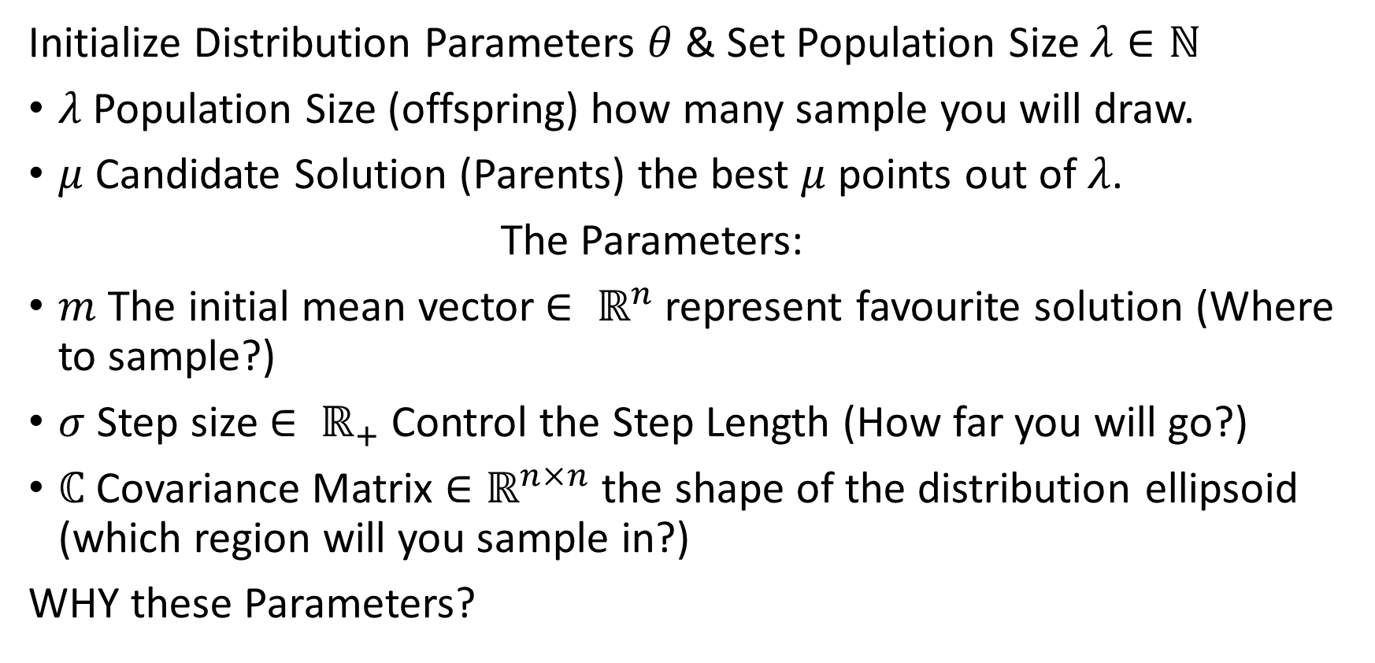
CMA – ES with Rank One Update
Initialize Distribution Parameters $θ$ & Set Population Size $λ∈ℕ$
$λ$ Population Size (offspring) how many sample you will draw.
$μ$ Candidate Solution (Parents) the best $μ$ points out of $λ$.
The Parameters:
$m$ The initial mean vector$∈ ℝ^{n}$represent favourite solution (Where to sample?)
$σ$ Step size $∈ ℝ_{+}$ Control the Step Length (How far you will go?)
$ℂ$ Covariance Matrix ${∈ℝ}^{n×n}$ the shape of the distribution ellipsoid (which region will you sample in?)
WHY these Parameters?

Slide 6
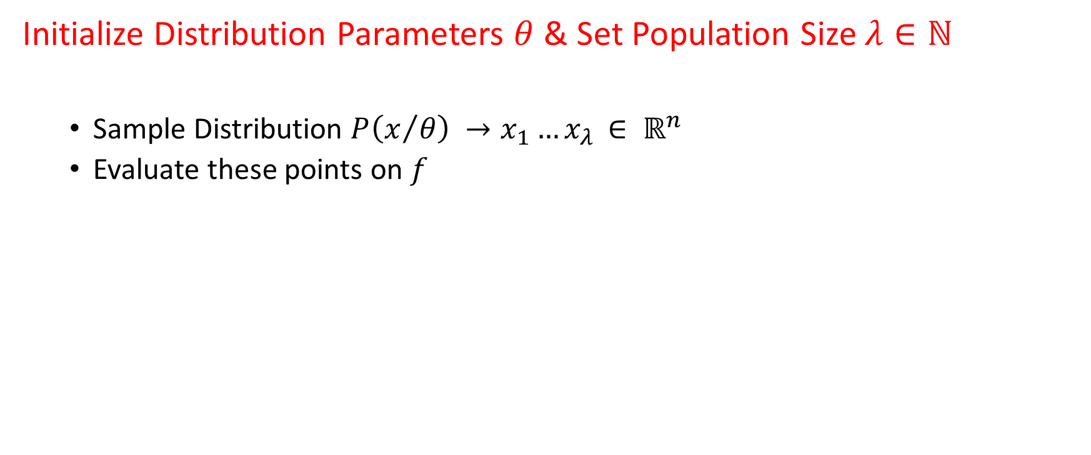
General Scheme for minimizing $f:ℝ^{n}→ℝ$ in black box search:
Initialize Distribution Parameters $θ$ & Set Population Size $λ∈ℕ$
Sample Distribution $P\left(x/θ\right) →x_{1}…x_{λ }∈ ℝ^{n}$
Evaluate these points on $f$

Slide 7
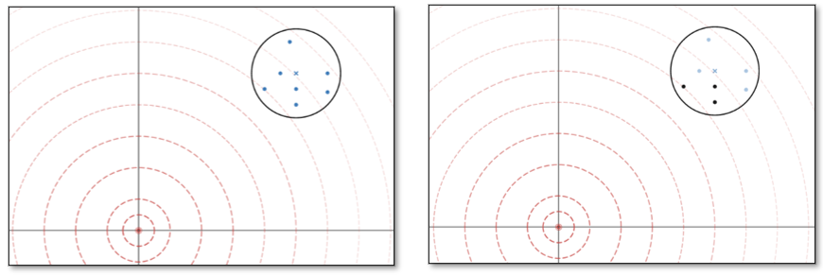
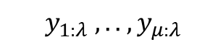
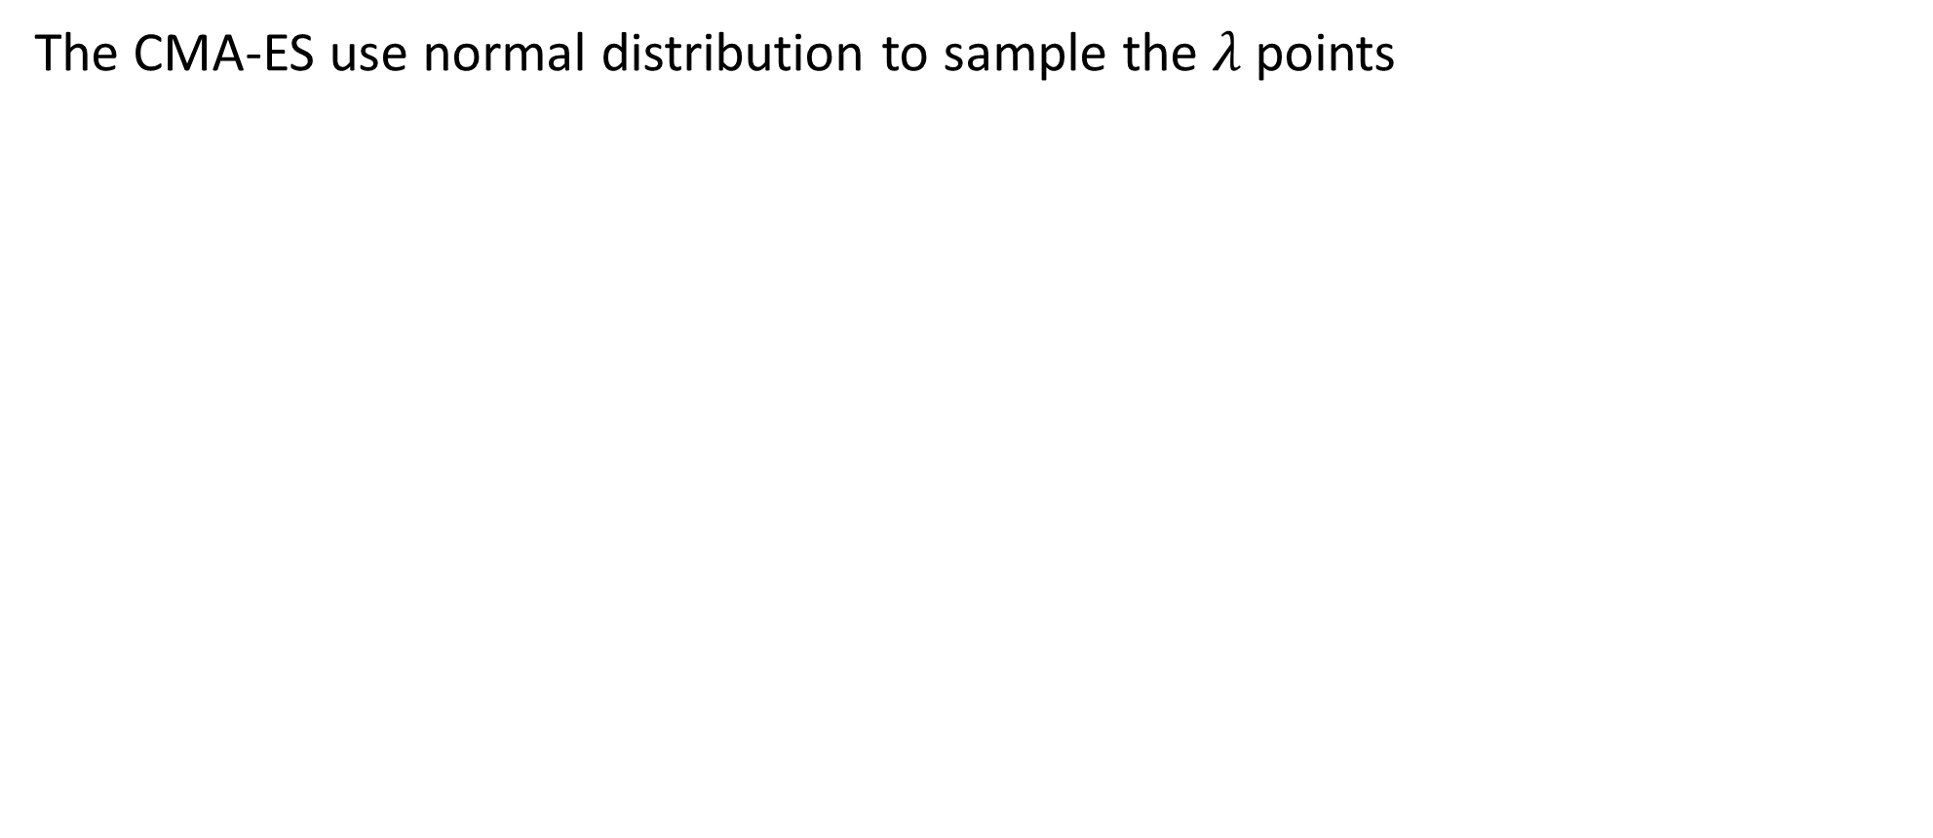
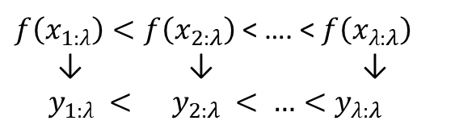
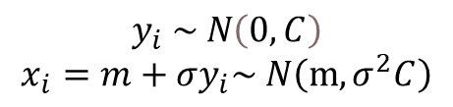
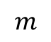
Sample Distribution:
The CMA-ES use normal distribution to sample the $λ$ points
$$y_{i} \sim N\left(0,C\right)$$
$$x_{i}=m+σy_{i}\sim N\left(m,σ^{2}C\right)$$
$$m$$
$f\left(x_{1:λ}\right)<f\left(x_{2:λ}\right)$ < …. < $f\left(x_{λ:λ}\right)$
↓ ↓ ↓
${ y}_{1:λ} <{ y}_{2:λ} < …<y_{λ:λ}$
$${ y}_{1:λ} , .. { ,y}_{μ:λ}$$
The Ranked
Directions

Slide 8
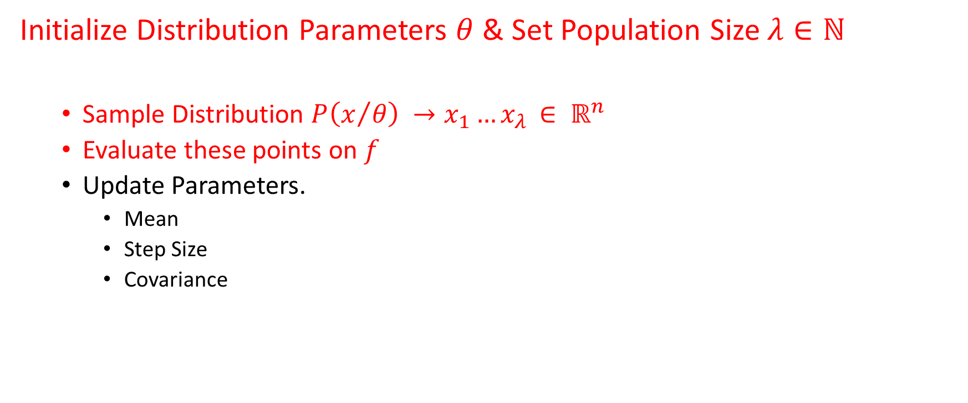
General Scheme for minimizing $f:ℝ^{n}→ℝ$ in black box search:
Initialize Distribution Parameters $θ$ & Set Population Size $λ∈ℕ$
Sample Distribution $P\left(x/θ\right) →x_{1}…x_{λ }∈ ℝ^{n}$
Evaluate these points on $f$
Update Parameters.
Mean
Step Size
Covariance

Slide 9

General Scheme for minimizing $f:ℝ^{n}→ℝ$ in black box search:
Initialize Distribution Parameters $θ$ & Set Population Size $λ∈ℕ$
Sample Distribution $P\left(x/θ\right) →x_{1}…x_{λ }∈ ℝ^{n}$
Evaluate these points on $f$
Update Parameters.
Mean

Slide 10
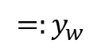
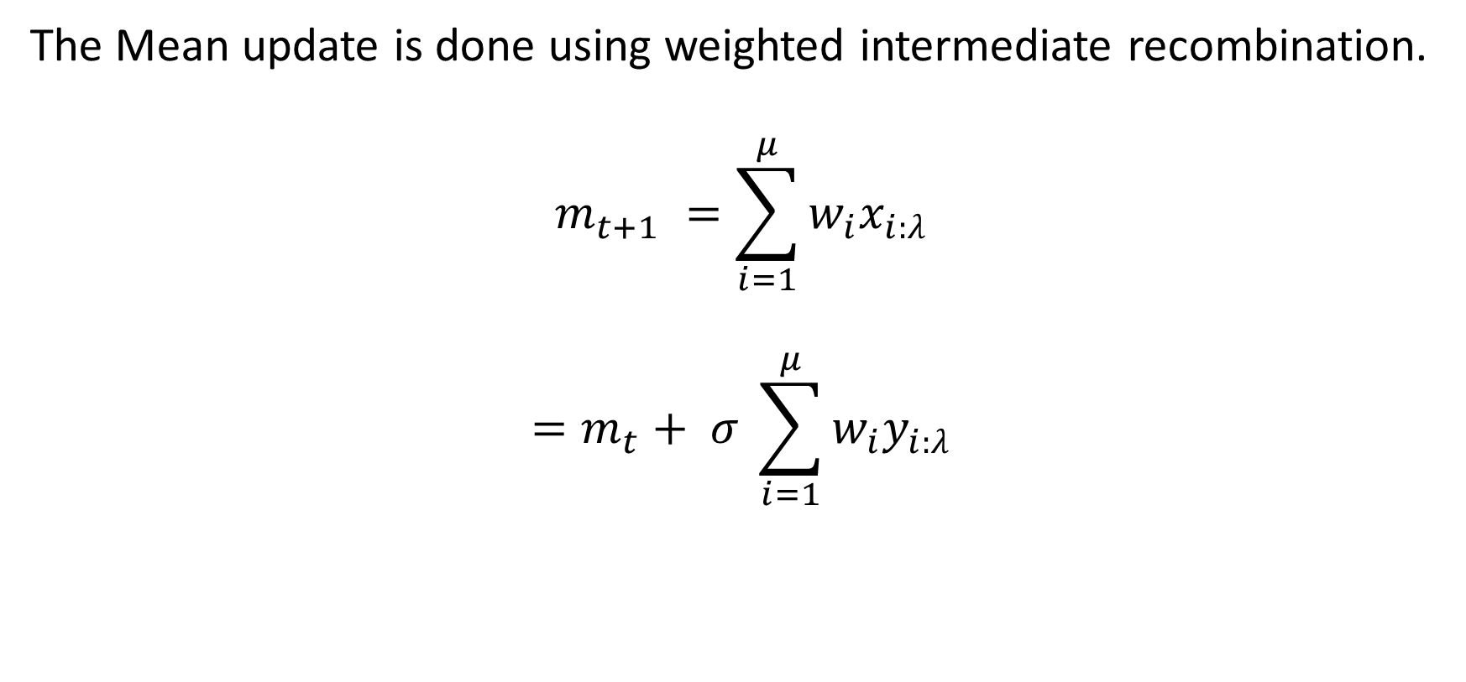
Mean Update
The Mean update is done using weighted intermediate recombination.
$$m_{t+1} =\sum_{i=1}^{μ}{w_{i}x_{i:λ}}$$
$$=m_{t}+ σ \sum_{i=1}^{μ}{w_{i}y_{i:λ}}$$
$$=:y_{w}$$

Slide 11
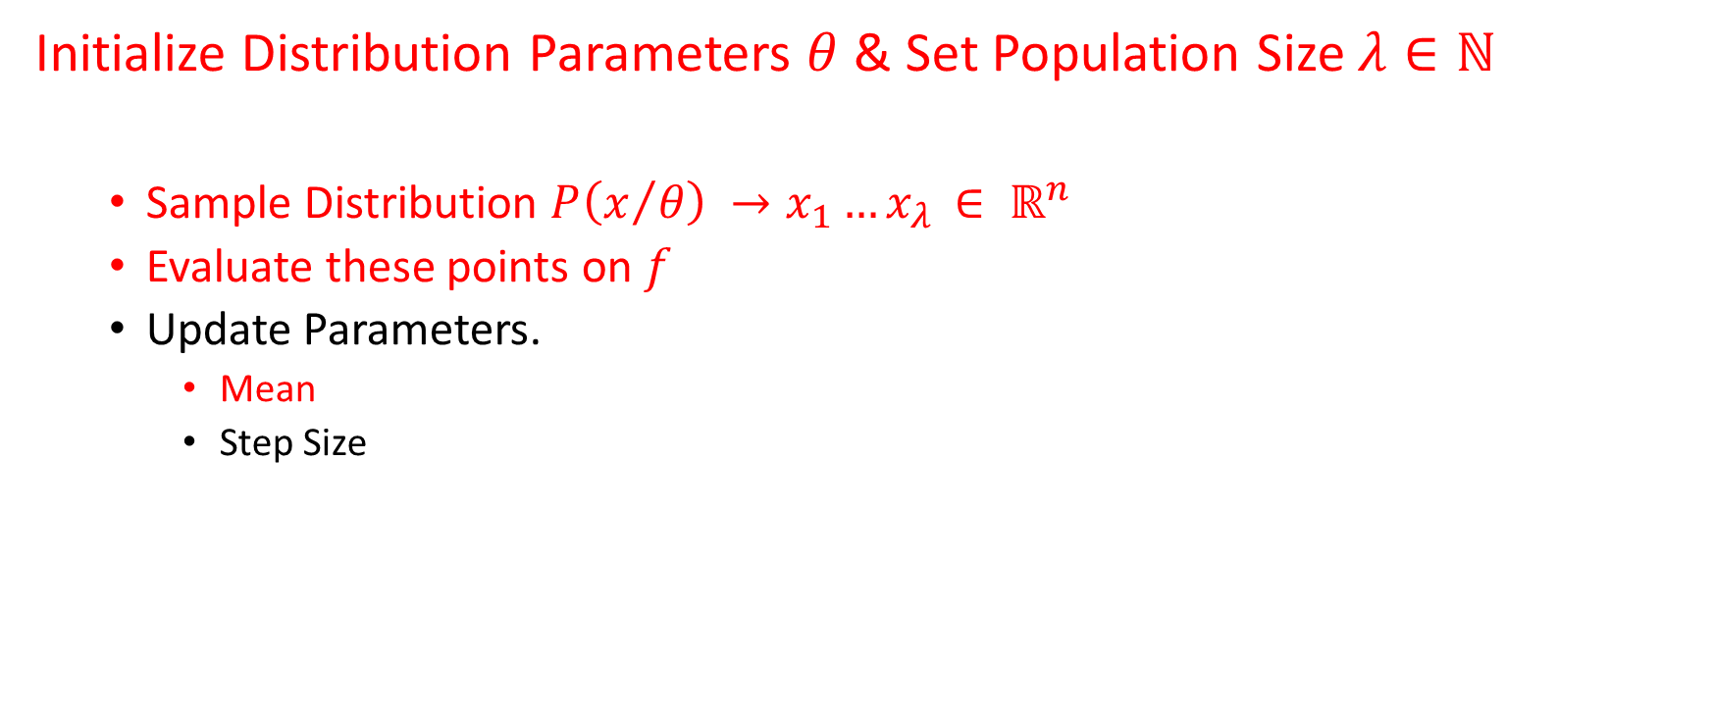
General Scheme for minimizing $f:ℝ^{n}→ℝ$ in black box search:
Initialize Distribution Parameters $θ$ & Set Population Size $λ∈ℕ$
Sample Distribution $P\left(x/θ\right) →x_{1}…x_{λ }∈ ℝ^{n}$
Evaluate these points on $f$
Update Parameters.
Mean
Step Size

Slide 12
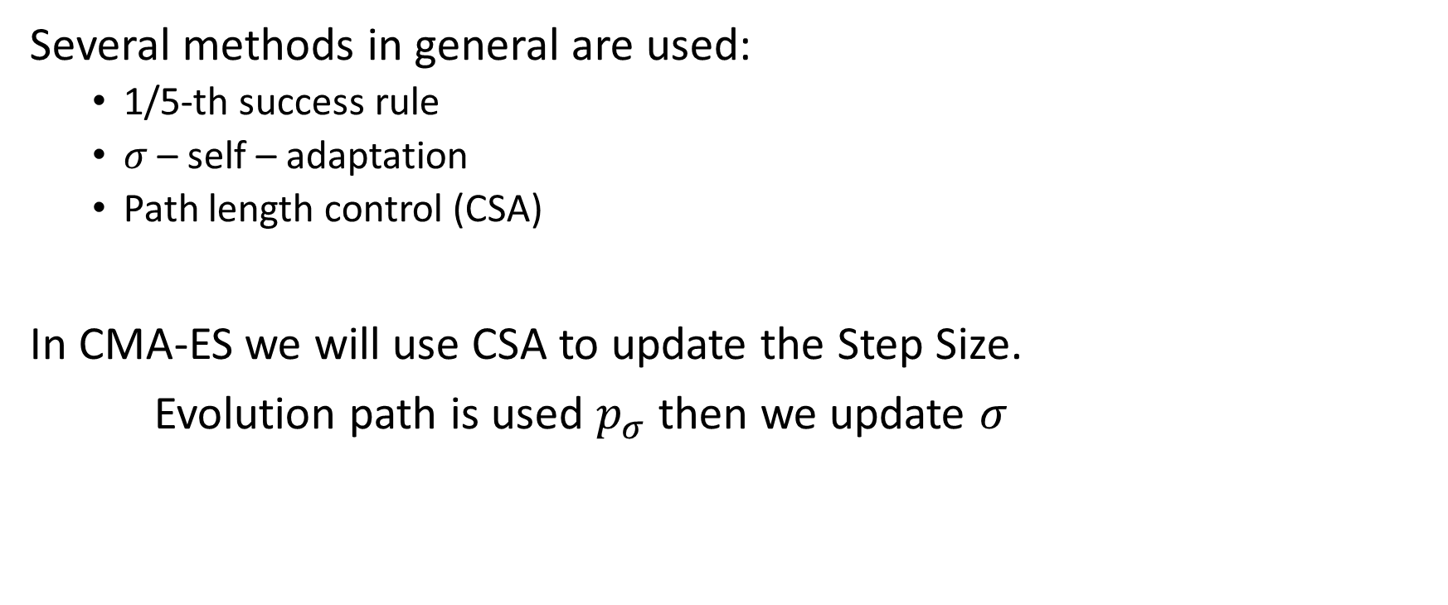
Step Size Update:
Several methods in general are used:
1/5-th success rule
$σ$ – self – adaptation
Path length control (CSA)
In CMA-ES we will use CSA to update the Step Size.
Evolution path is used $p_{σ}$ then we update $σ$

Slide 13
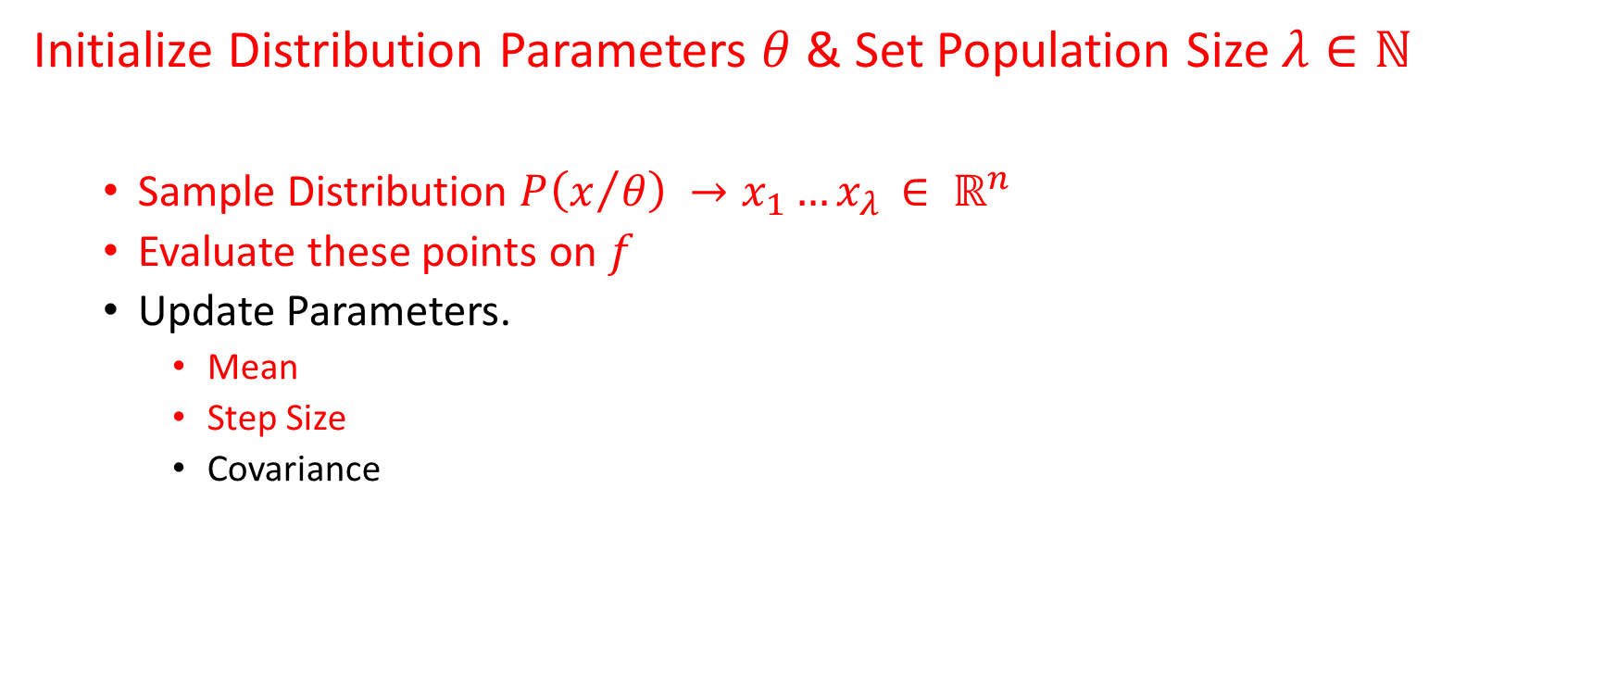
General Scheme for minimizing $f:ℝ^{n}→ℝ$ in black box search:
Initialize Distribution Parameters $θ$ & Set Population Size $λ∈ℕ$
Sample Distribution $P\left(x/θ\right) →x_{1}…x_{λ }∈ ℝ^{n}$
Evaluate these points on $f$
Update Parameters.
Mean
Step Size
Covariance

Slide 14
Now The Covariance Matrix Update.
Motivation:
Step size control is not enough (why?)
Because convergence speed of CSA-ES becomes lower as function become ill conditioned

Slide 15
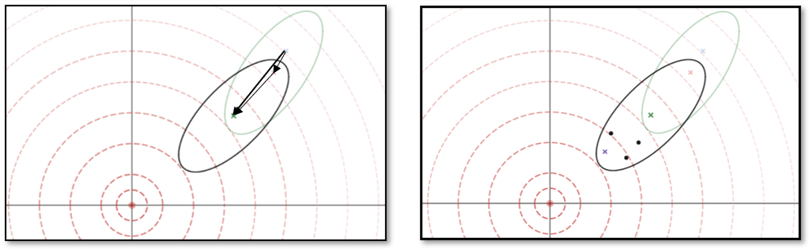
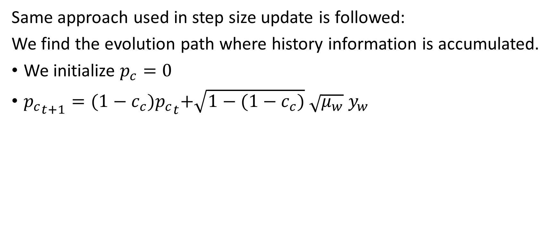
Cumulation….
Same approach used in step size update is followed:
We find the evolution path where history information is accumulated.
We initialize $p_{c}=0$
${p_{c}}_{t+1}={(1−c_{c})p_{c}}_{t}+\sqrt{1−(1−c_{c})} \sqrt{μ_{w}} y_{w}$

Slide 16
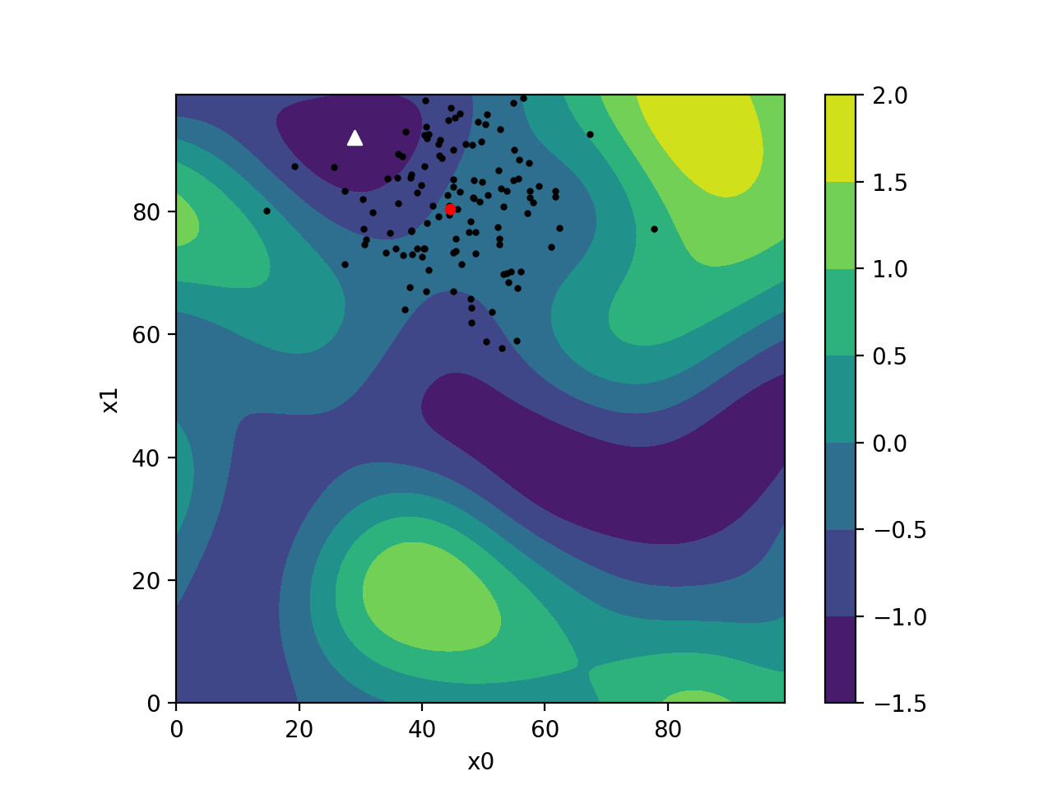
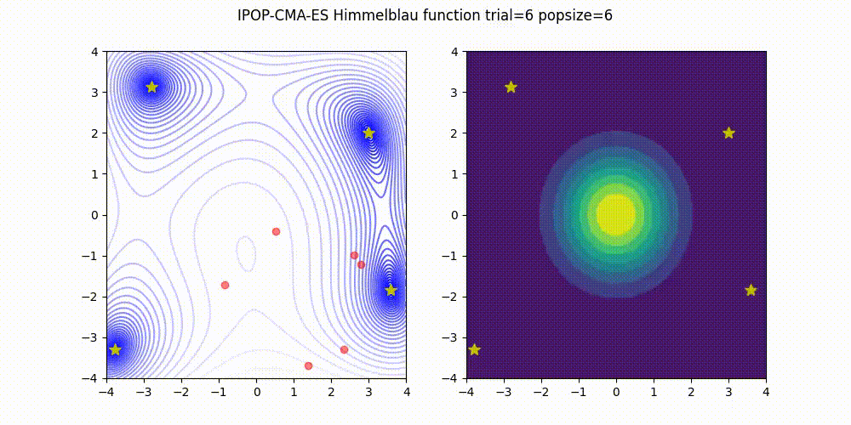
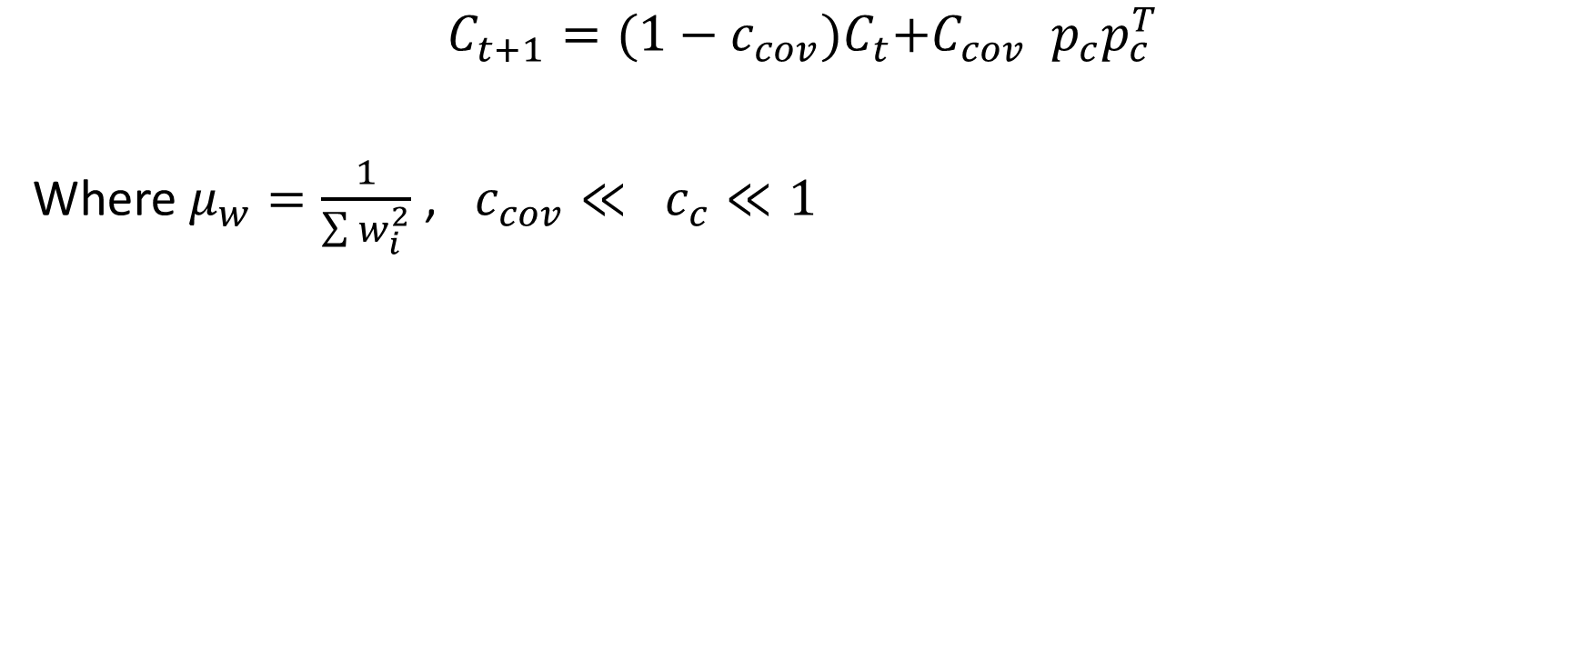
Finally The Covariance Update:
This is a
Matrix of
Rank one
$$C_{t+1}={(1−c_{cov})C}_{t}+C_{cov} p_{c}p_{c}^{T}$$
Where$μ_{w}=\frac{1}{\sum{w_{i}^{2}}}$ , $c_{cov}≪ c_{c}≪1$
Source1: https://medium.com/optuna/introduction-to-cma-es-sampler-ee68194c8f88 Source2: https://thurinj.github.io/CMA-ES.html

Slide 17
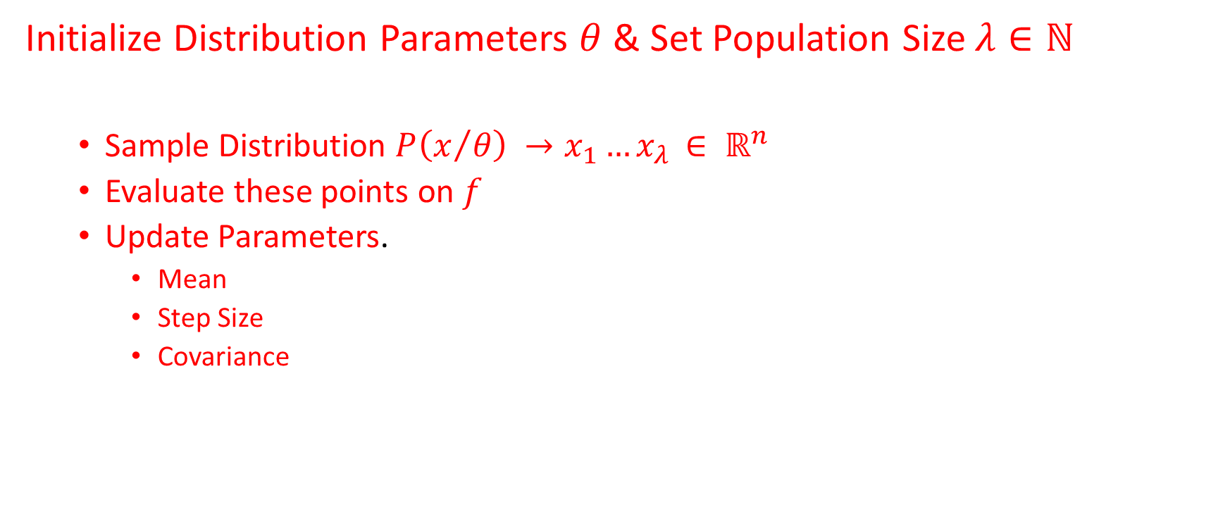
General Scheme for minimizing $f:ℝ^{n}→ℝ$ in black box search:
Initialize Distribution Parameters $θ$ & Set Population Size $λ∈ℕ$
Sample Distribution $P\left(x/θ\right) →x_{1}…x_{λ }∈ ℝ^{n}$
Evaluate these points on $f$
Update Parameters.
Mean
Step Size
Covariance

Slide 18
Benchmark?

Slide 19
How to track the performance of CMA-ES rank one?
In Order to study the performance of CMA-ES with rank one update we used COCO platform and benchmarked it on BBOB Noiseless Suite.

Slide 20
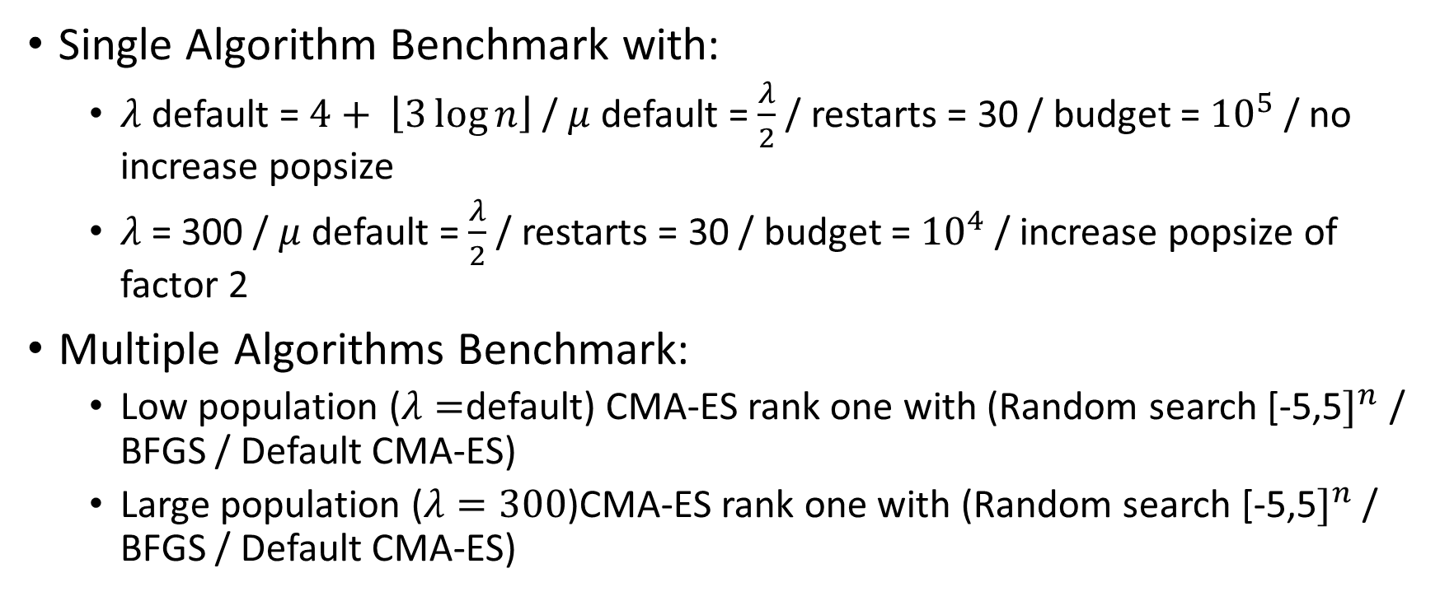
Tests Conducted:
Single Algorithm Benchmark with:
$λ$ default = $4+ \left\lfloor 3\log{n}\right\rfloor$ / $μ$ default = $\frac{λ}{2}$ / restarts = 30 / budget = ${10}^{5}$ / no increase popsize
$λ$ = 300 / $μ$ default = $\frac{λ}{2}$ / restarts = 30 / budget = ${10}^{4}$ / increase popsize of factor 2
Multiple Algorithms Benchmark:
Low population ($λ=$default) CMA-ES rank one with (Random search [-5,5$]^{n}$ / BFGS / Default CMA-ES)
Large population ($λ=300$)CMA-ES rank one with (Random search [-5,5$]^{n}$/ BFGS / Default CMA-ES)

Slide 21
BBOB Test Suite:
24 Noiseless Functions Separated to:
1 Separable Functions
f1 | Sphere Function
f2 | Separable Ellipsoidal Function
f3 | Rastrigin Function
f4 | Büche-Rastrigin Function
f5 | Linear Slope
2 Functions with low or moderate conditioning
f6 | Attractive Sector Function
f7 | Step Ellipsoidal Function
f8 | Rosenbrock Function, original
f9 | Rosenbrock Function, rotated
3 Functions with high conditioning and unimodal
f10 | Ellipsoidal Function
f11 | Discus Function
f12 | Bent Cigar Function
f13 | Sharp Ridge Function
f14 | Different Powers Function
4 Multi-modal functions with adequate global structure
f15 | Rastrigin Function
f16 | Weierstrass Function
f17 | Schaffer's F7 Function
f18 | Schaffer's F7 Function, moderately ill-conditioned
f19 | Composite Griewank-Rosenbrock Function F8F2
5 Multi-modal functions with weak global structure
f20 | Schwefel Function
f21 | Gallagher's Gaussian 101-me Peaks Function
f22 | Gallagher's Gaussian 21-hi Peaks Function
f23 | Katsuura Function
f24 | Lunacek bi-Rastrigin Function

Slide 22
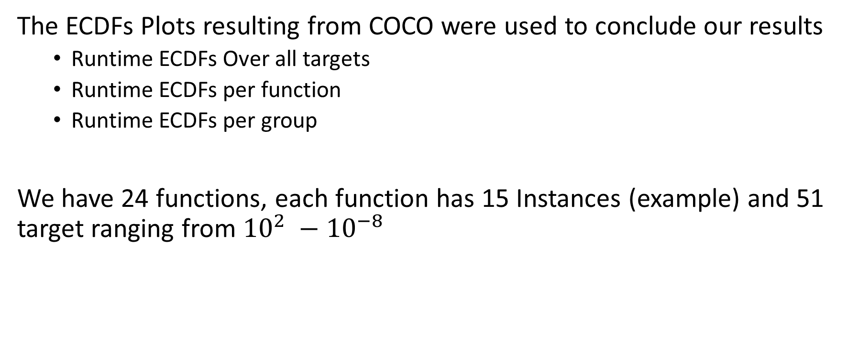
(Instance, Target) Pairs
The ECDFs Plots resulting from COCO were used to conclude our results
Runtime ECDFs Over all targets
Runtime ECDFs per function
Runtime ECDFs per group
We have 24 functions, each function has 15 Instances (example) and 51 target ranging from ${10}^{2} −{10}^{−8 }$

Slide 23
Next, Results……. With Low Population Size

Slide 24
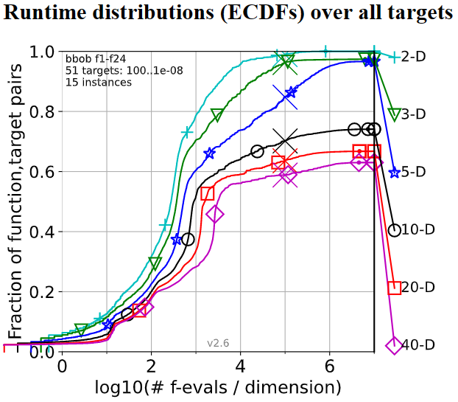
Where the algorithm in dimension D stop
Percentage of (Instance, Target) pairs that were met (solved)
Budget Multiplier
#F-eval=Budget Multiplier*D

Slide 25
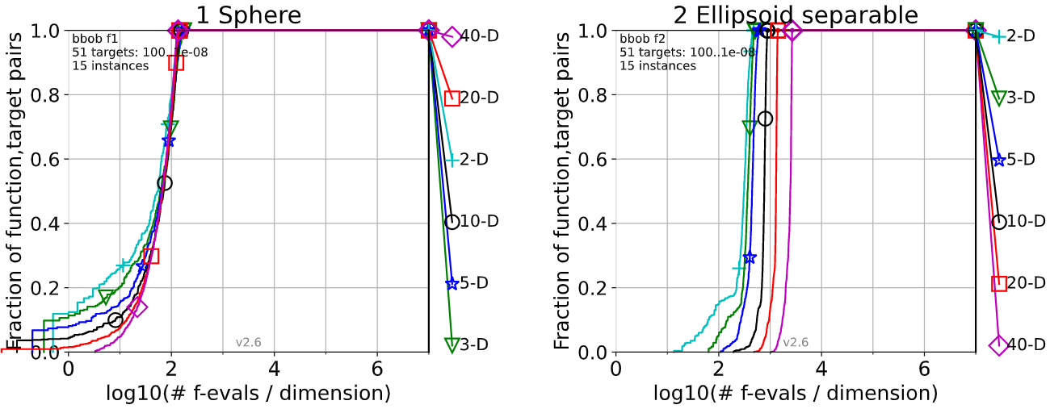
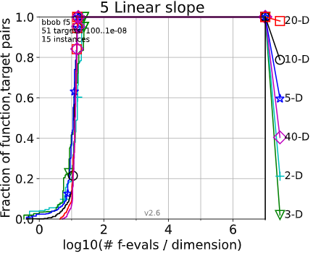
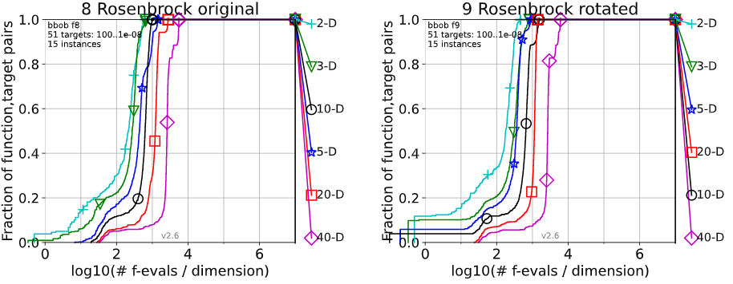
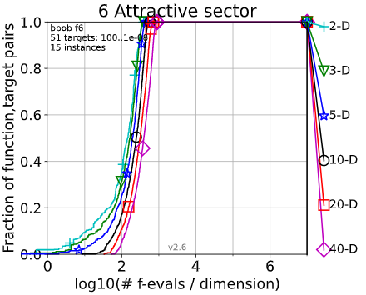
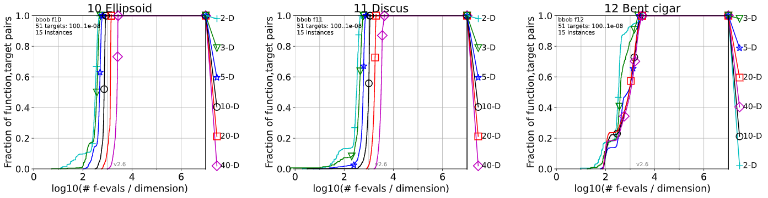
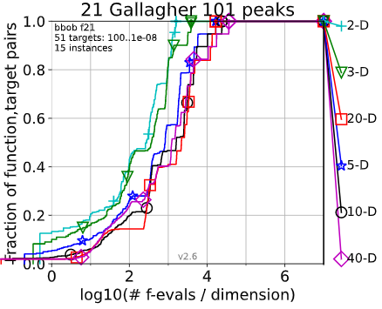
The Functions (f1, f2, f5, f6, f8, f9, f10, f11, f12, f21) have been solved!
Separable Functions
Multi-Modal Functions with Weak Global Structure
Functions with Low or Moderate Conditioning
Functions with High Conditioning and Uni-modal

Slide 26
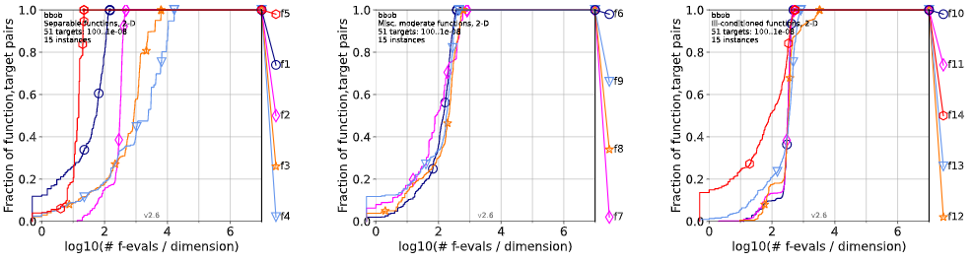
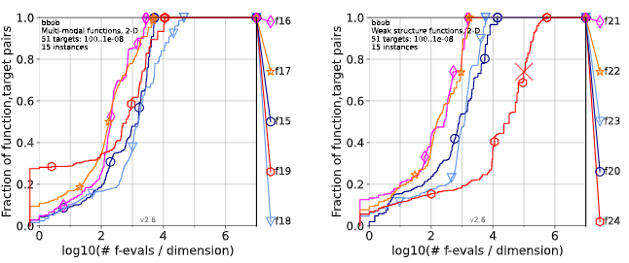
In 2D all functions were solved except f24
In Higher Dimension
Curies of Dimensionality!

Slide 27
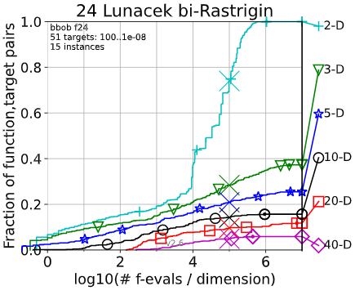
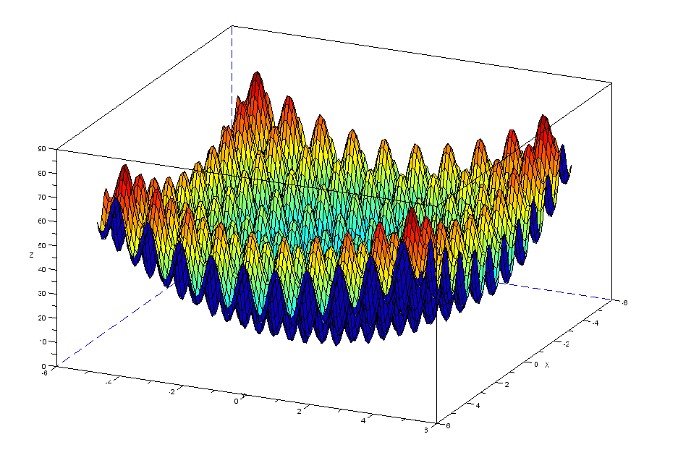
F24 Lunacek bi-Rastrigin unsolved in all for all dimensions
.
Multi-Modal Function
.
Need high population size

Slide 28
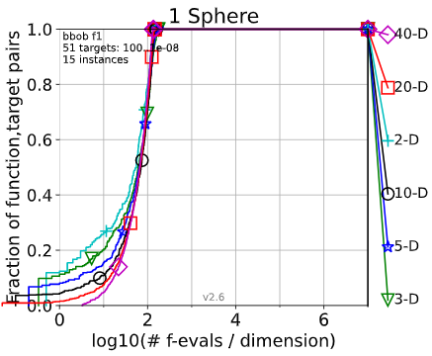
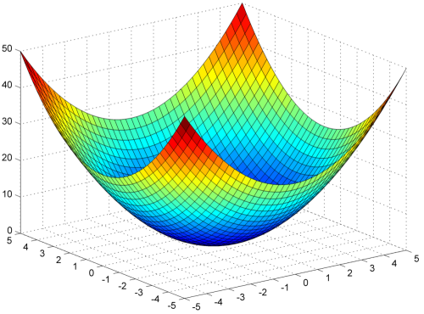
F1 sphere function was completely solved in all dimensions in budget =${10}^{2}$
.
Separable Function
.
Uni-Modal Function

Slide 29
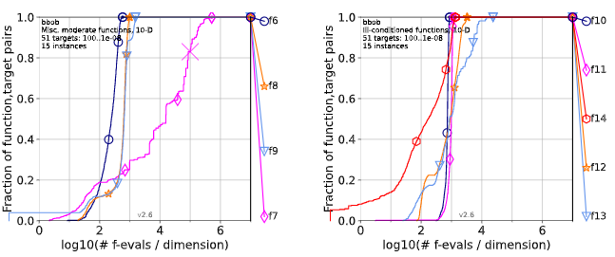
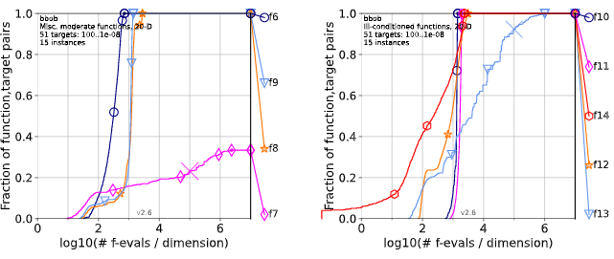
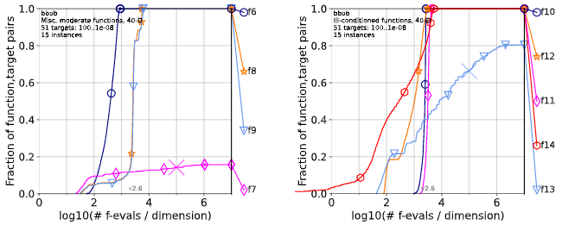
10D
20D
40D
Class two and three were all solved in all dimensions except f7 in 10,20 and 40D with very bad performance in 20,40D and also f13 in 20,40D it needed more budget.

Slide 30
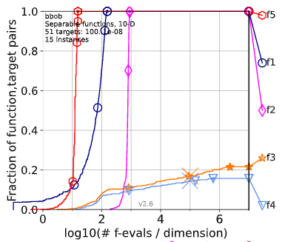
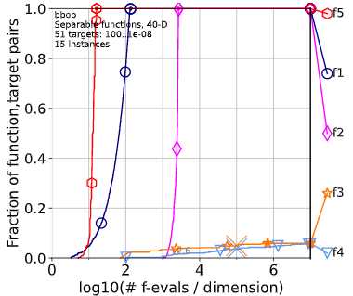
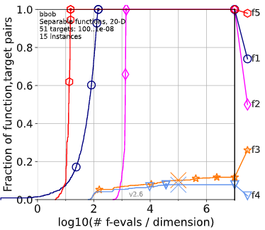
Separable functions did a very high performance except for: F3,f4 not even 20% of them was solved in 10,20,40D
10D
40D
20D

Slide 31
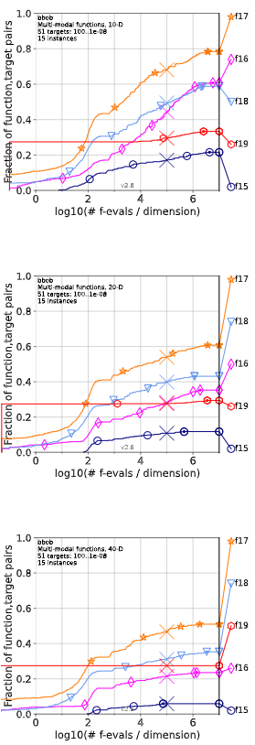
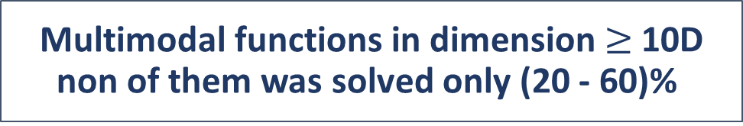
Multimodal functions in dimension $≥$10D non of them was solved only (20 - 60)%

Slide 32
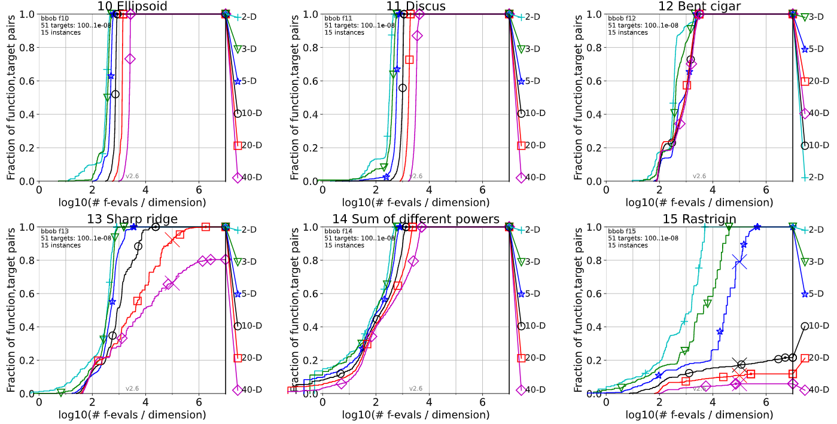
Uni-modal Functions on low dimensions were completely solved except f13 because it is not smooth

Slide 33
Now comparing the algorithm with the other algorithms
RANDOMSEARCH-5
BFGS SciPy 2019
BIPOP CMA ES Hansen noiseless
best 2009: which is an algorithm that takes the best parameters among a 31 Algorithms

Slide 34
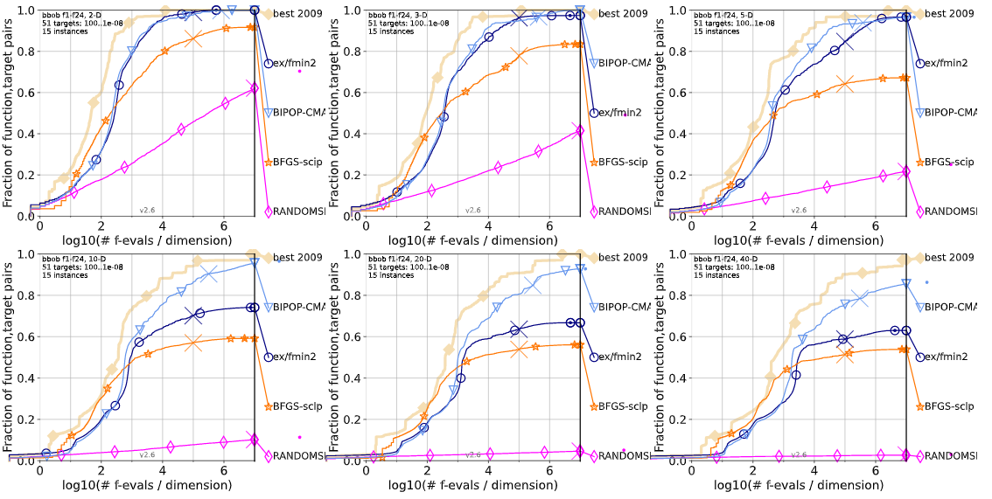
Performance of rank one was very close to performance of BIPOP-CMA-ES for all functions over all targets up to 5D

Slide 35
Up to budget${10}^{3}$ in all cases default CMA and rank one had same performance in general.

Slide 36
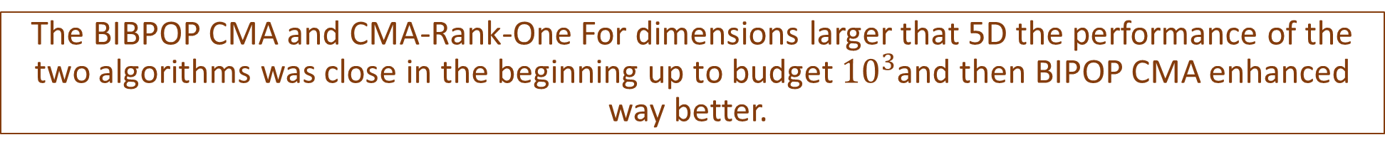
The BIBPOP CMA and CMA-Rank-One For dimensions larger that 5D the performance of the two algorithms was close in the beginning up to budget ${10}^{3}$and then BIPOP CMA enhanced way better.

Slide 37
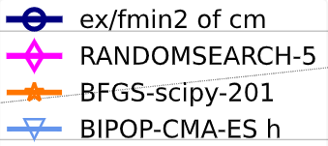


Generally speaking rank one update did better than BFGS-SciPy and Random-search in the most of the Functions.

Slide 38
performance of rank one update was very close to Best 2009 for 2D, 3D and 5D.

Slide 39

For separable functions default CMA, rank one and BFGS had same performance among all dimensions.

Slide 40

Multimodal functions with adequate global structure, rank one did not solve all dimensions unlike default.

Slide 41


F21 was completely solved with rank one with a performance very close to best 2009 in all dimensions.
Rank-one fails to solve f24 because this function was designed to make evolution strategy fail.

Slide 42
Next: Results With High Population Size

Slide 43

Results for High Population Trial
$λ$ very high

Slide 44






21 Functions which their (instance,target) pairs were not solved
Except for f5 which is linear slope function.
2D
3D
5D
10D
20D
40D

Slide 45


Unusual Notes !!!!
We saw that the (instance,target) pairs of f1 function (sphere function) were not solved in 2D,3D with D*10^4 function evaluations.
2D
3D

Slide 46




Which for 5D,10D,20D & 40D all the pairs were completely solved with the budget we have 10^4.
10D
5D
20D
40D

Slide 47




Also for f17(Schaffers F7 Function)
The pairs were not solved in 2D,3D,5D & 10D

Slide 48


While it got completely solved in 20D & 40D

Slide 49






For the 3rd class (High conditioning and unimodal functions) less than 40% of (instance,target) pairs were solved even with being unimodal , the performance was very low!!

Slide 50
On the other hand for this class the Scipy algorithm has a very high performance.

Slide 51

Generally Speaking around 40% of the (instance,target) pairs were solved with rank1 on all functions in all dimensions.

Slide 52
Compare between Rank 1 and other algorithms

Slide 53

The performance of CMAES with rank 1 update is close to random search algorithm in 2D which was really bad!!

Slide 54
The performance of BFGs scipy algorithm went down on larger dimensions and become close to CMAES rank 1 update.
The gap between rank 1 and best 2009 algorithm was very large.

Slide 55
When it’s good to use CMAES with rank1
Conclusion:
1- Low population size :
If f is unimodal.
If f is separable +unimodal.
In low D : all classes of functions.
2- High population size:
If f is linear slope function.
In High D : just 2 functions : f is sphere or chaffers F7.

